Slide 1
ESL
BY: Cristian Lopez

Slide 2
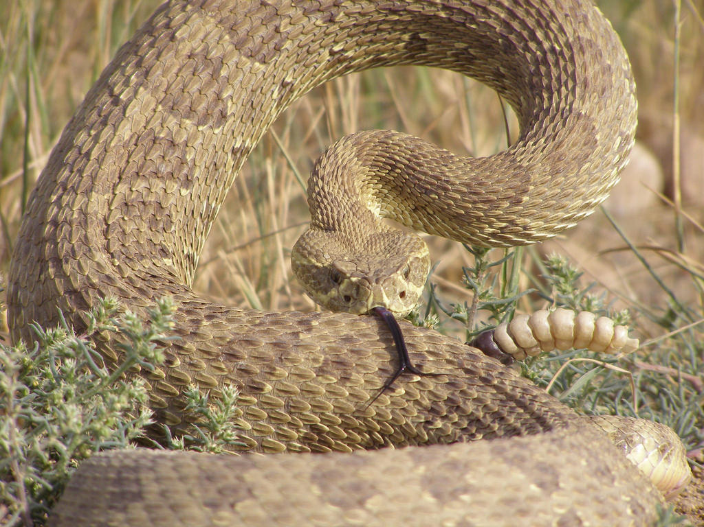
1 Poisonous:
Causing harm or death by poison.
Synonym: harmful.

Slide 3
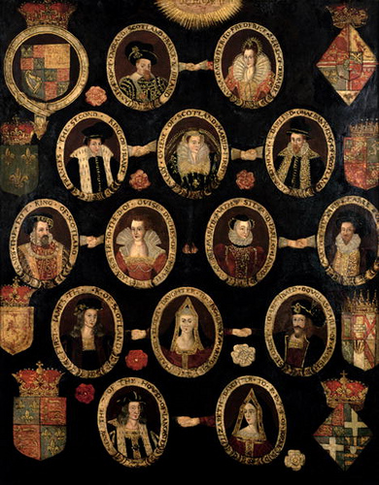
2 Ancestors:
The people from whom one is descended (great-grandmother, father, and so on).
.
Synonym: predecessor in family.

Slide 4
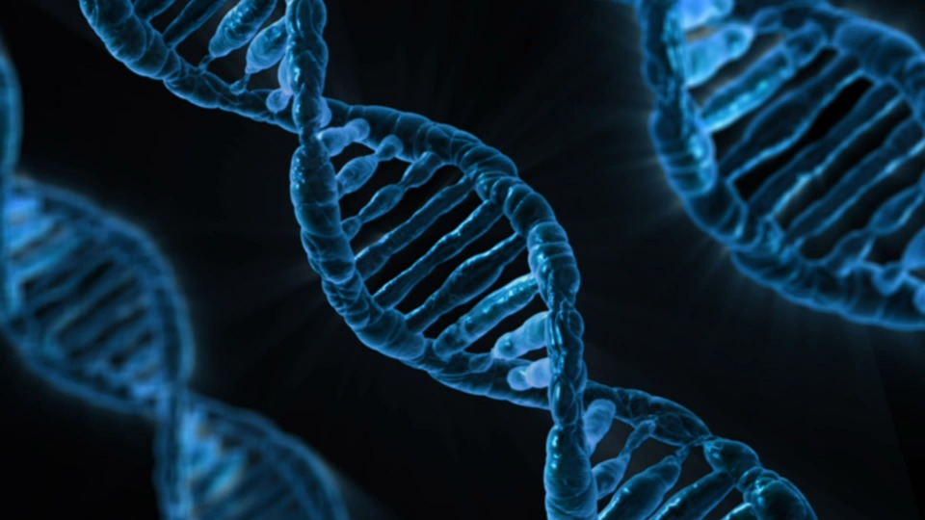
3 Genes:
The basic part of a living cell that contains characteristics of one’s parents.
Synonym: DNA.

Slide 5
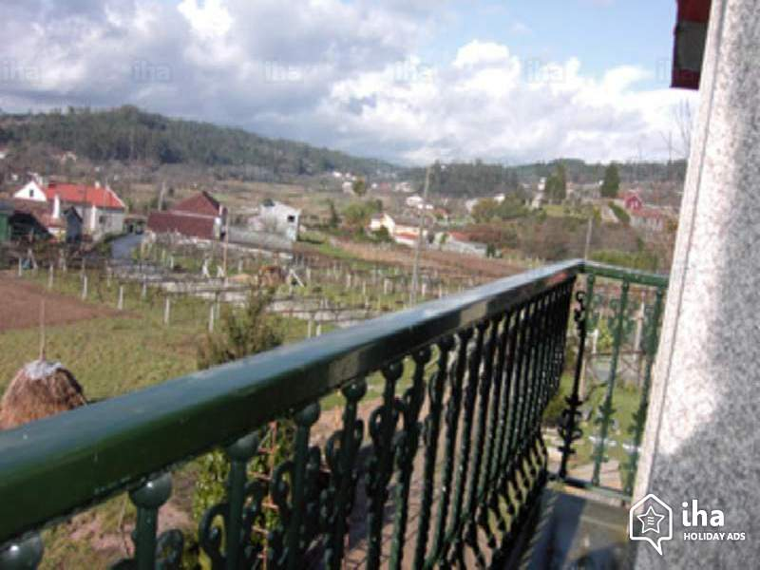
4 Rural:
Related to the countryside, not the city.
Synonym: country, not urban.

Slide 6
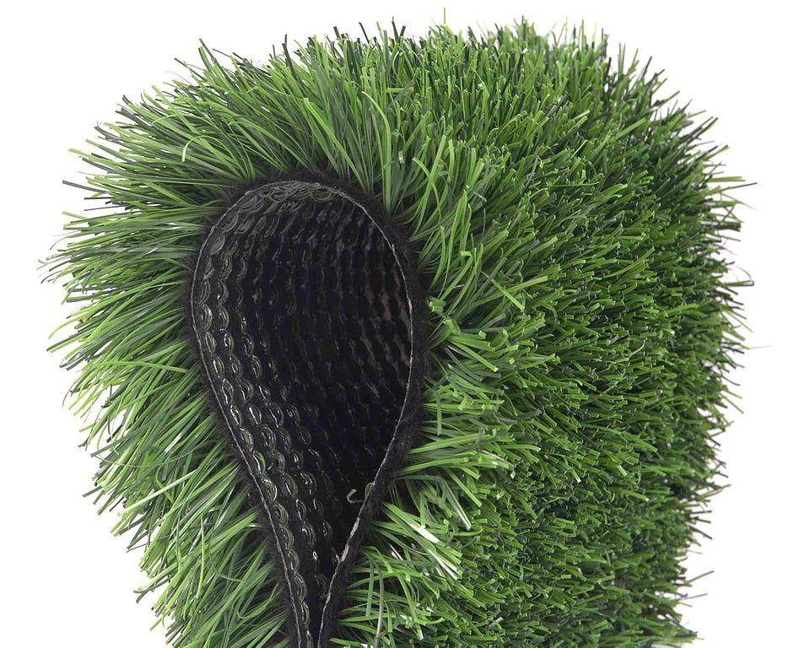
5 Artificial:
Made by humans, not made from natural things.
Synonym: fake, imitation.

Slide 7
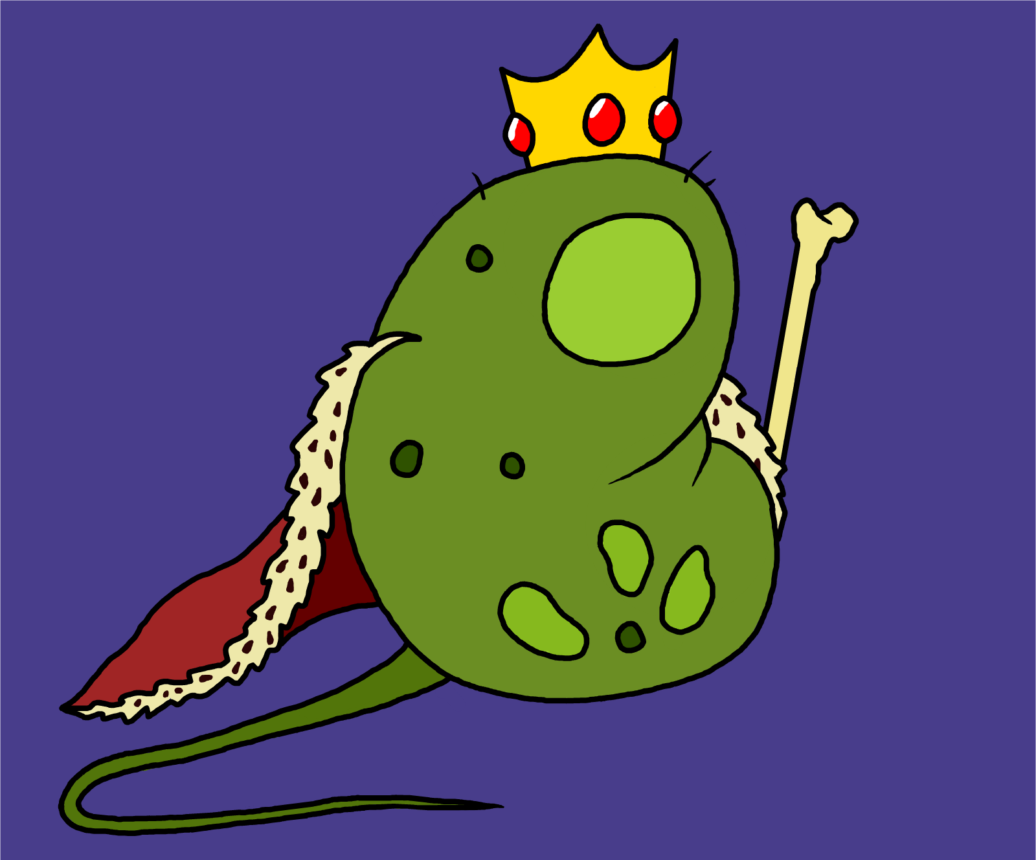
6 Bacteria:
Tiny living things; many cause disease.
Synonym: microorganisms

Slide 8
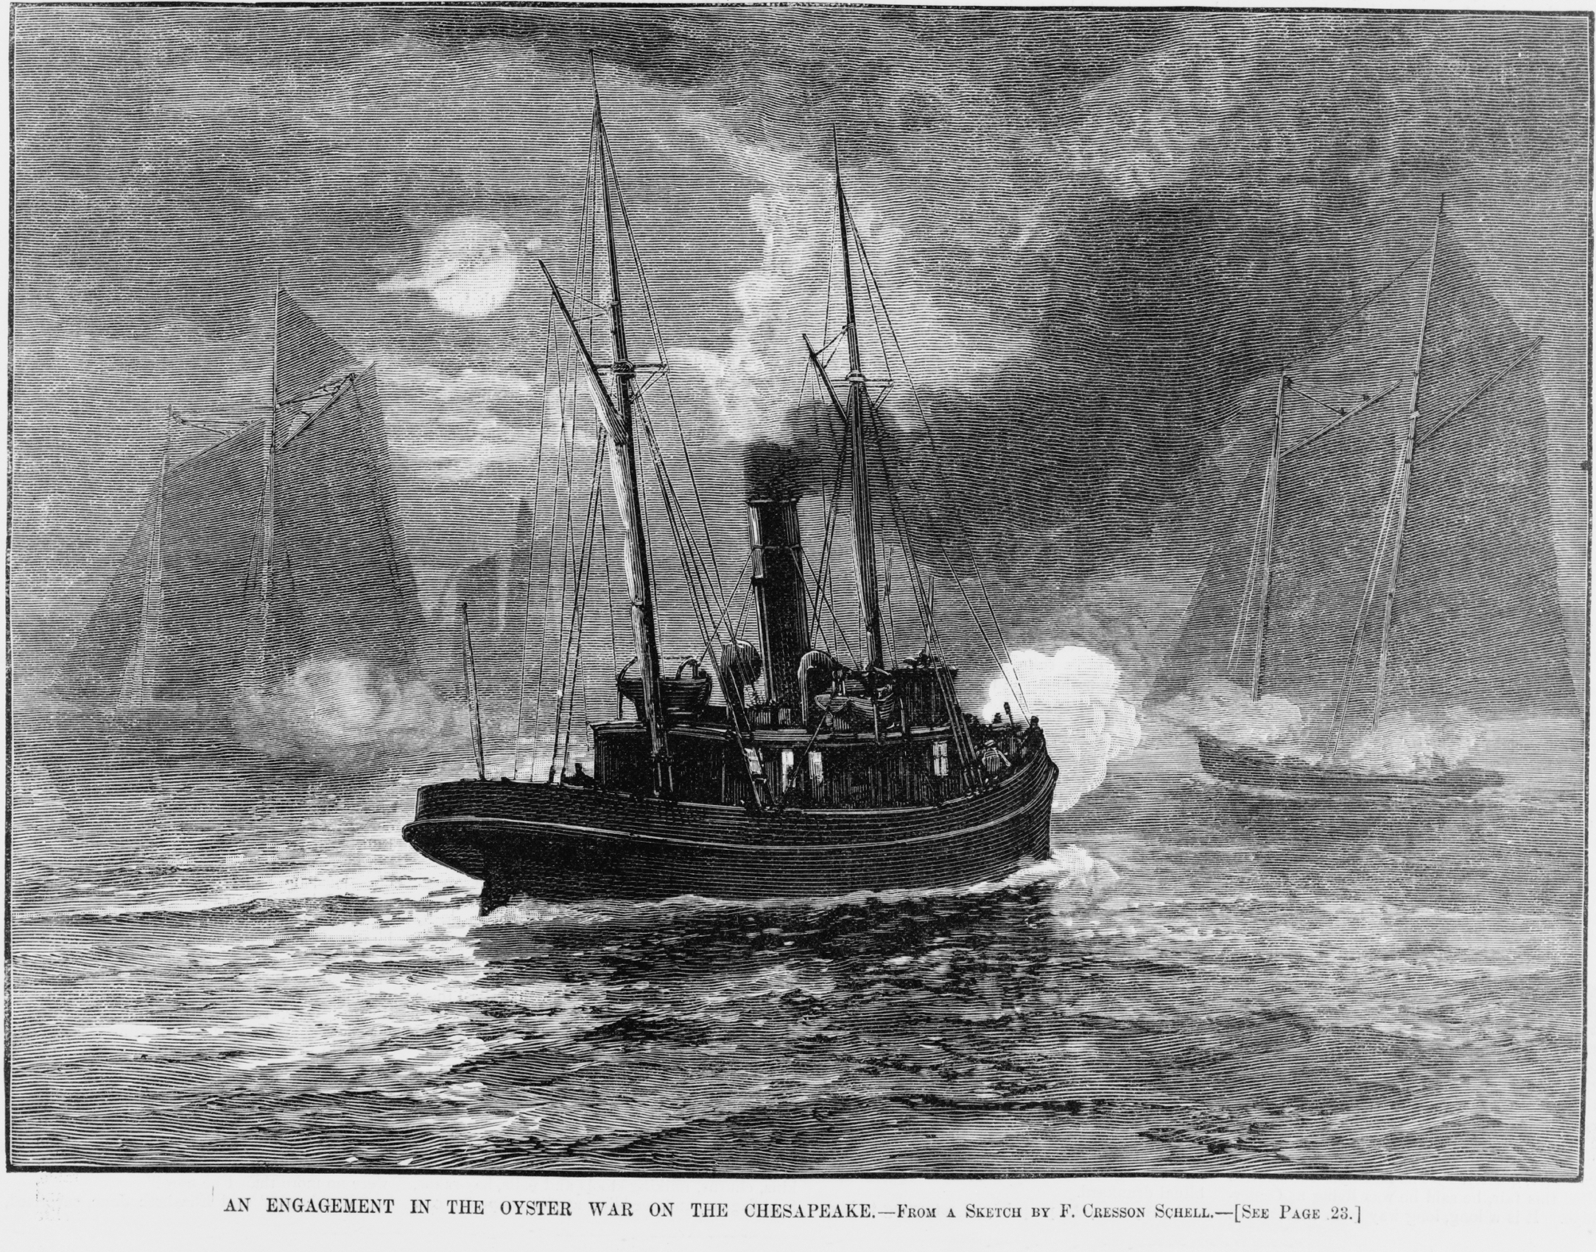
7 Impurities:
Dirty or bad things.
Synonym: contaminant.

Slide 9
8 Sky-diving:
Jumping out of an airplane and floating to the ground with the help of a parachute.
Synonym: parachuter.

Slide 10
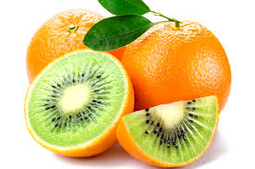
9 Genetically Modified:
Changed or altered in something’s genes.
Synonym: convert

Slide 11
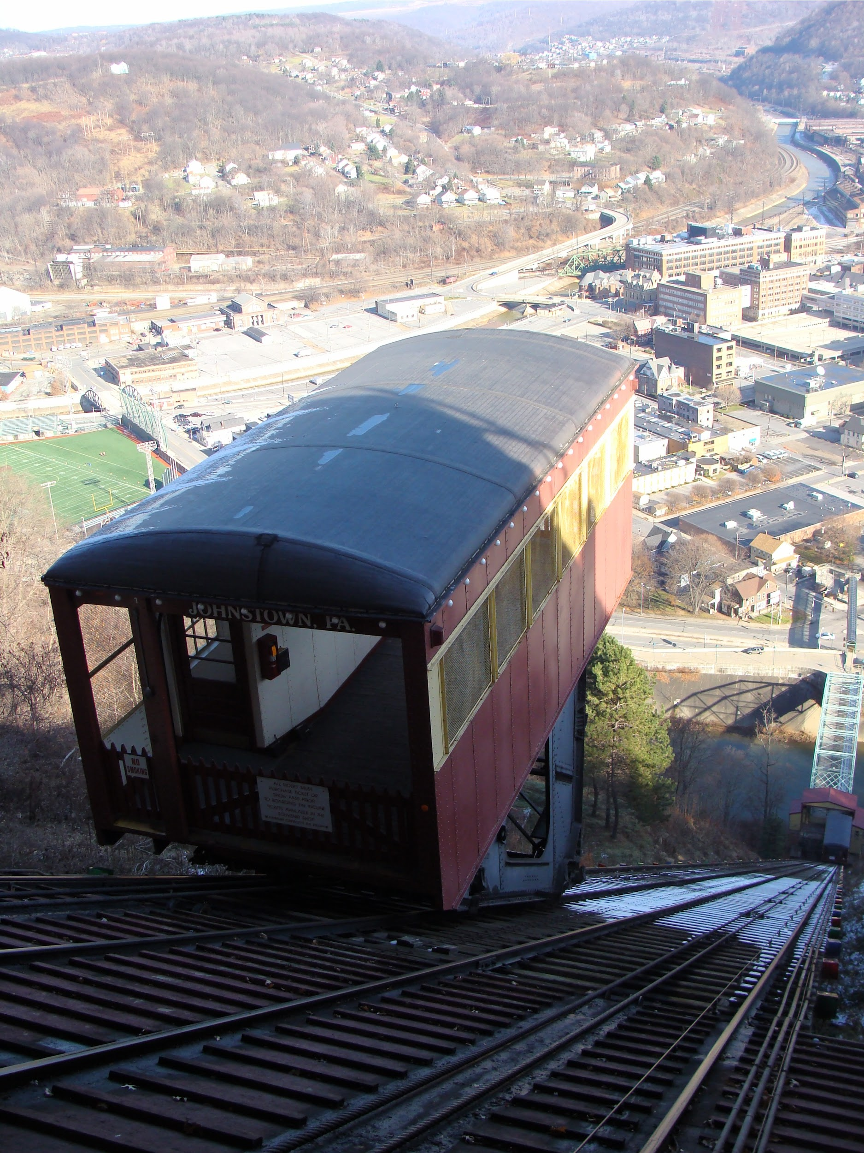
10 Inclined:
Likely to.
Synonym: having a preference.

Slide 12
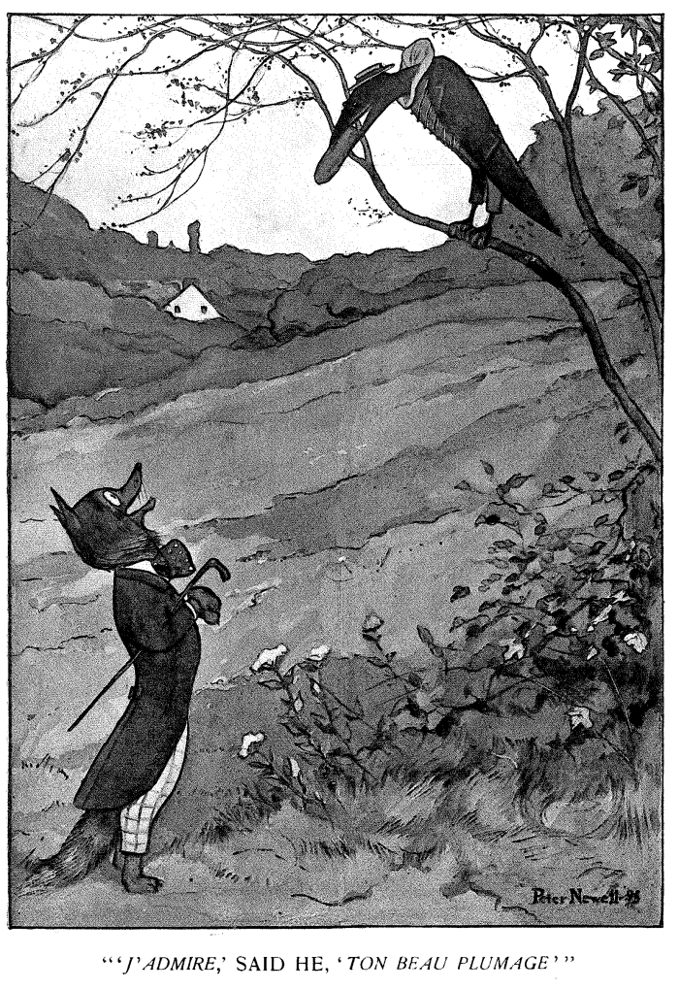
11 Untrustworthy:
Dishonest.
Synonym: not dependable, unfaithful.

Slide 13
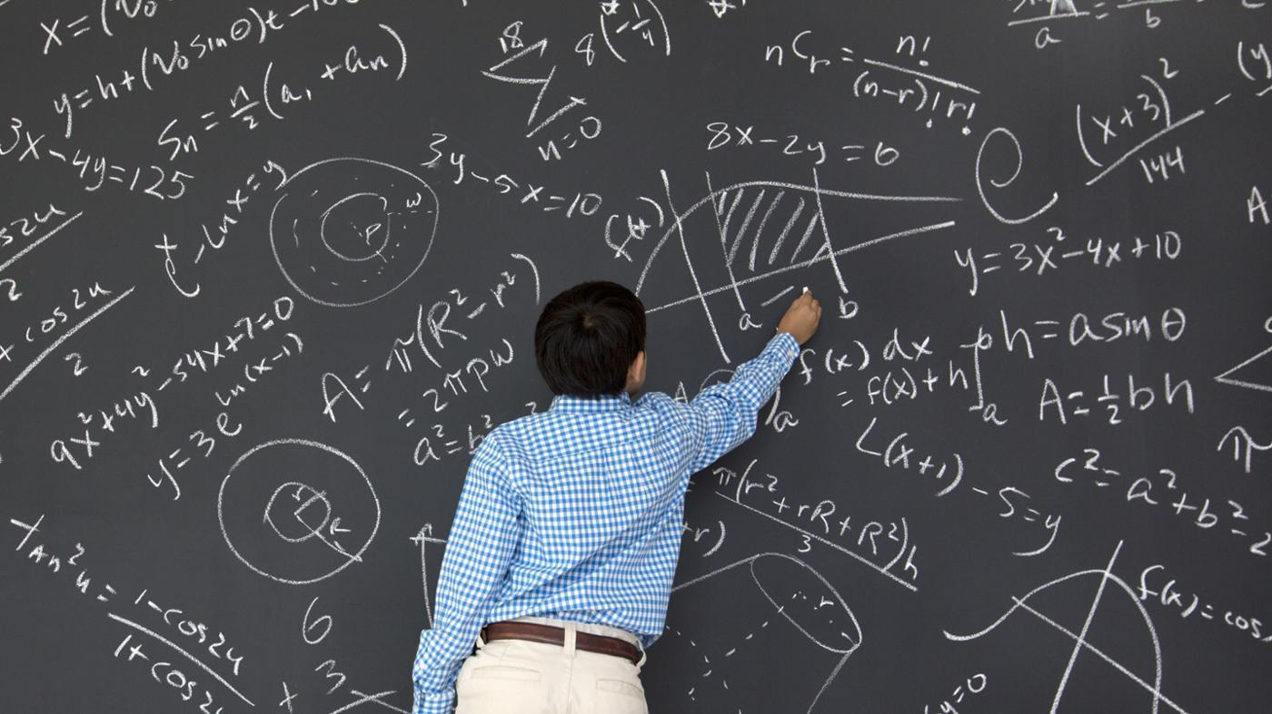
12 Tendency:
An inclination or habit.
Synonym: do in a certain way.

Slide 14
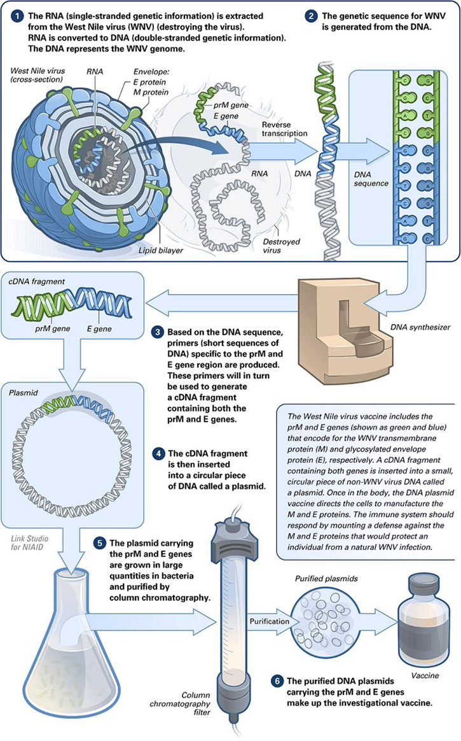
13 Vaccines:
Medication taken to prevent many diseases.
Synonym: shot of medicine.

Slide 15
14 Psychologists:
People who study human and animal behavior.
Synonym: person who treats mental.

Slide 16
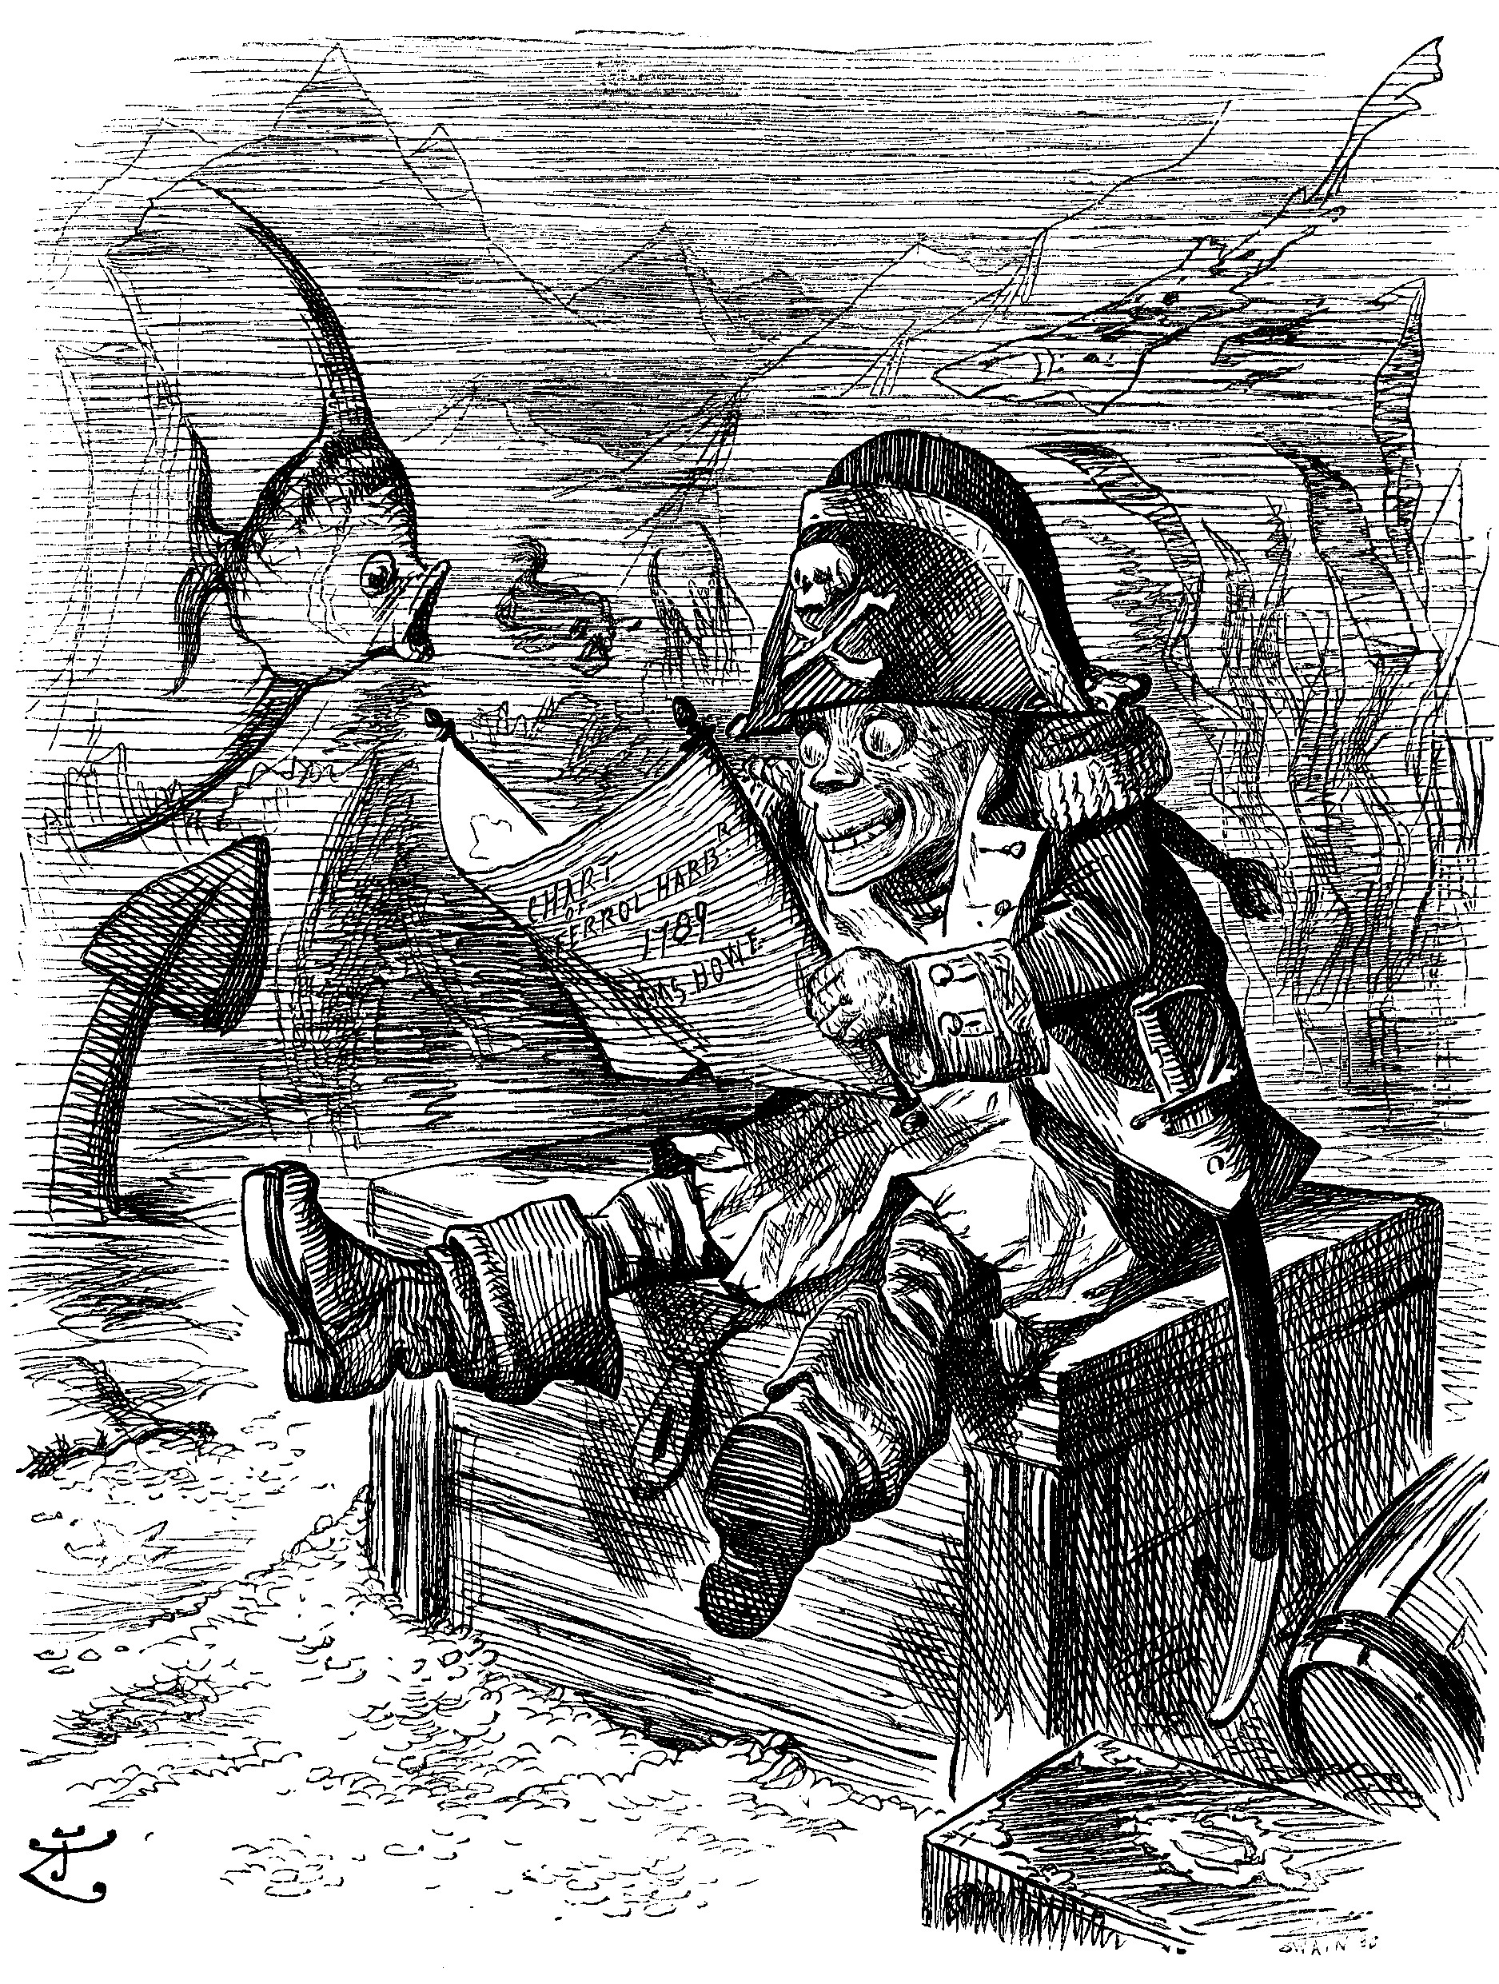
15 Dread:
A strong fear something happening in the future.
Synonym: anticipate with horror.

Slide 17
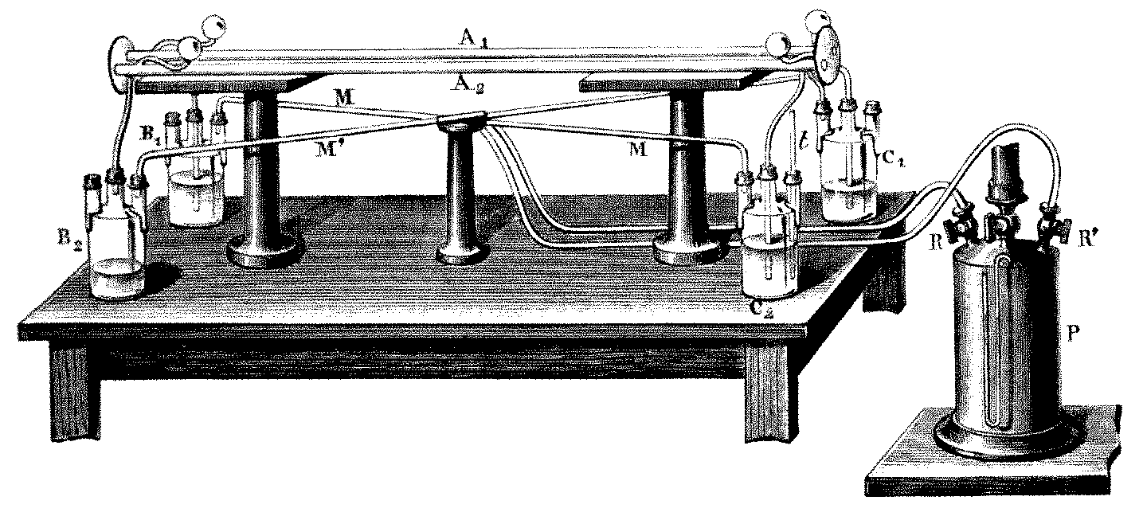
16 Outcome:
The effect or result.
Synonym: consequence, effect

Slide 18
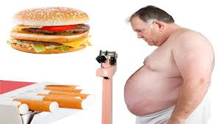
17 Factor:
A fact to be considered.
Synonym: determinant.

Slide 19
18 Significant:
Large or meaningful.
Synonym: telling, meaningful.

Slide 20
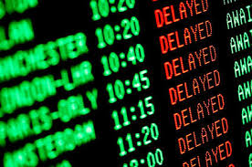
19 Delayed:
Moved to a later time.
Synonym: held up.

Slide 21
20 Biases:
General tendencies.
Synonym: cause to favor.

