Slide 1
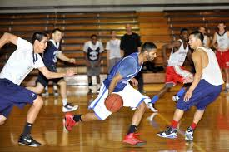
Verb | Simple Past | Affirmative Statement
have | had | I had basketball practice.

Slide 2
Verb | Simple Past | Affirmative Statement
do | did | You did homework last night.

Slide 3
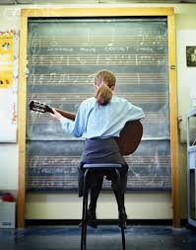
Verb | Simple Past | Affirmative Statement
go | went | She went to guitar practice.

Slide 4
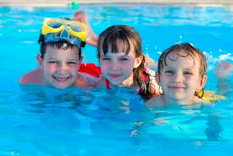
Verb | Simple Past | Affirmative Statement
say | said | She said let’s go to the pool.

Slide 5
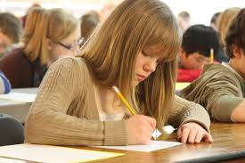
Verb | Simple Past | Affirmative Statement
take | took | We took a spelling quiz on Friday.

Slide 6
Verb | Simple Past | Affirmative Statement
write | wrote | They wrote the teacher an e-mail.

Slide 7
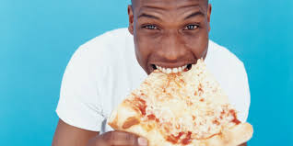
Verb | Simple Past | Affirmative Statement
eat | ate | He ate pizza for lunch.

