Slide 1
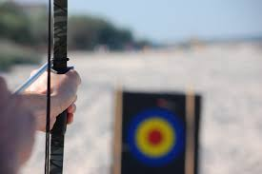
Aiming
Pointing at directing toward
Synonym: DIRECT

Slide 2
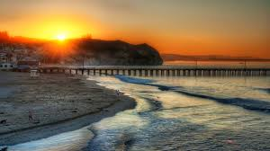
Coastal
Along the coast where the land and water meet
Synonyms : littorals

Slide 3
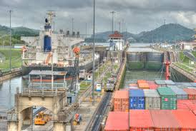
Freighter
A ship designed to carry freight , goods ,or cargo
synonyms: car

Slide 4
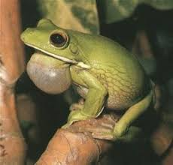
Croaked
Made a deep sound like a frog
Synonyms : rasp

Slide 5
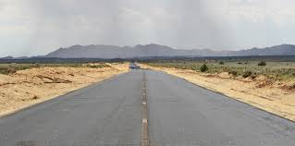
Rumble
Make a low rolling
Synonyms :roar

Slide 6
Bridge
The part of a ship where the officers stand to give orders
Synonym: Overpass

Slide 7
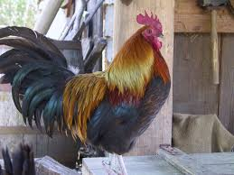
Cocky
Feeling sure of one’s importance and abilities
Synonym: Arrogant

Slide 8
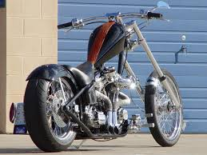
Choppers
Helicopters
Synonyms : molar

Slide 9
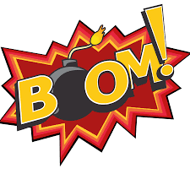
Boom
A long, horizontal pole that holds the bottom of a sail on boat
Synonyms : rumble

Slide 10
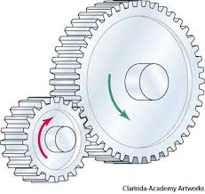
Gear
Equipment
Synonyms :apparatus

Slide 11
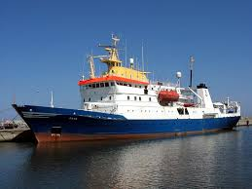
Research vessel
A boat built for study
Synonyms : barge

Slide 12
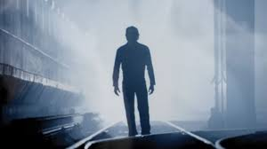
Shrugged
Lifted his shoulders upward a sign of not caring or not knowing
Synonyms : disregard

Slide 13
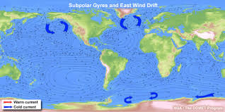
Drift
Definition: float, carried by wind or water currents
Synonym: be carried

Slide 14
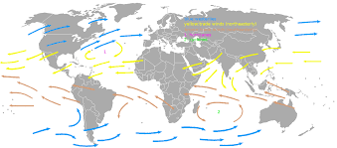
Prevailing
Definition: usual, frequent
Synonym: win

Slide 15
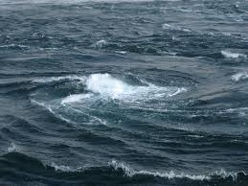
Current
Definition: the flow
Synonym: present

Slide 16
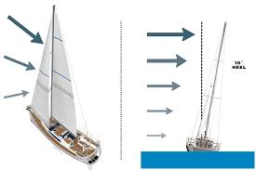
Tack
Definition: change direction depending on the wind
Synonym: course

Slide 17
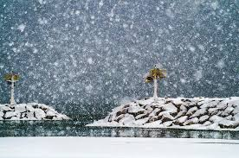
Flurried
Definition: flowed lightly
Synonym: perturbed

Slide 18
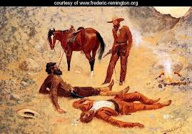
Jerked
Definition: pulled quickly and sharply
Synonym: pull

Slide 19
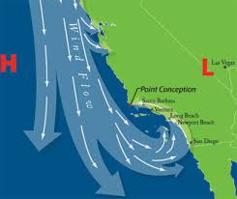
Eddy
Definition: turning or swirling wind
Synonym: vortex

Slide 20
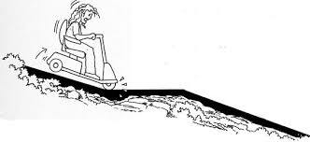
Abruptly
Definition: in a sudden manner
Synonym: suddenly

Slide 21
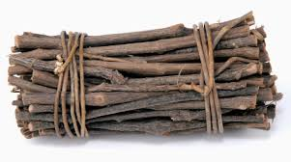
Bundle
Definition: things close together usually tired or fastened
Synonym: packet

Slide 22
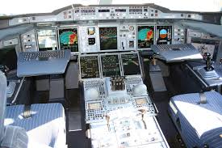
Cockpit
Definition: the area of a boat where the captain stands
Synonym: compartment

Slide 23
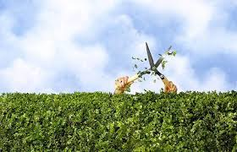
Trimming
Definition: placing the sails in the direction of the wind
Synonym: extras

Slide 24
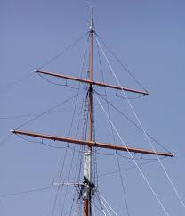
Mast
Definition: a pole on a boat to which the sails are connected
Synonym: yard

